Slide 1
Iteration - while loops

Slide 2
Iteration - for and while loops
Iteration occurs when we instruct the computer to carry out a task over and over again by repeating a section of code.
The piece of code is called a loop.
Python provide built in support for two different kinds of iteration statements/loops.
The while loop
The for loop

Slide 3
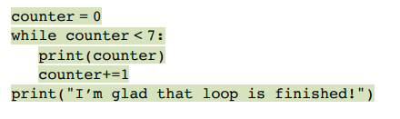
While Loops
A while loop keeps repeating while a certain condition is true.
It stops when the condition is false. If this doesn’t happen then the loop could go on forever.
https://repl.it/join/kfzhdbyr-suzannelinnane

Slide 4
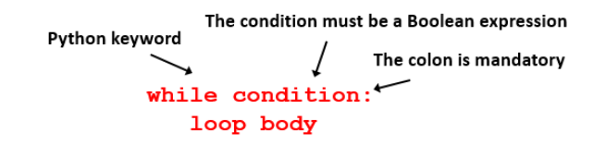
The while loop
The while loop begins with the keyword while, followed by a condition (made up by the programmer!)
If the result of the statement is True, then the code in the loop body is executed.
When Python reaches the last line of the loop body, it loops back to the condition which is evaluated again. This continues until the result of the condition is False.

Slide 5
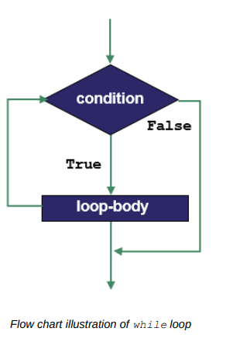

Slide 6
The while loop
It is the programmer’s responsibility to ensure that the loop body contains a line of code that will cause the loop condition to eventually become False.
Otherwise the loop will never terminate. Such loops are called infinite loops.
It is also possible for the loop body never to be executed.
This happens when the condition evaluates to False before the first iteration.

Slide 7
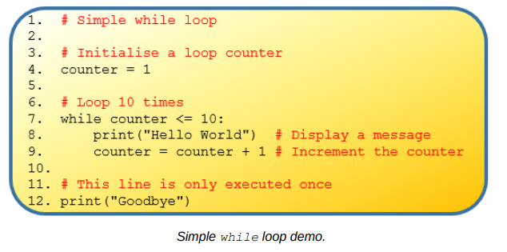

Slide 8
Uses of while loops
Sometimes repetition is required that is not for a fixed number of iterations.
For example checking a user password until it is correct.
This is often referred to as a sentinel controlled loop and is frequently used for validation (ways to check something is correct).

Slide 9
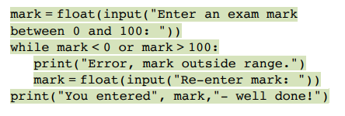
Example:
Enter an exam mark which must be between 0 to 100.
If the user enters a mark that falls outside this range, then they are asked to re-enter it until it is inside the range.
https://repl.it/join/xiajaynb-suzannelinnane

Slide 10
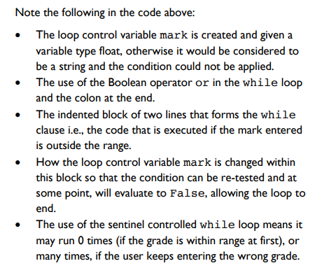

Slide 11
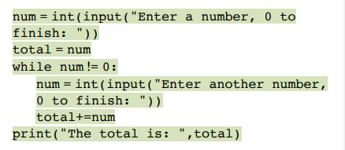
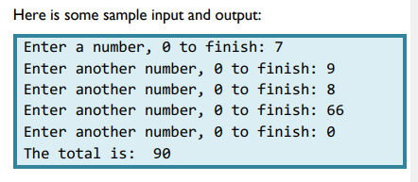
Example: Enter numbers that are to be added together. When the user enters 0, the loop terminates

